Slide 1
PROJECT 4
OBESITY LEVELS
CLASSIFICATION
Group Seven
Team members
Gilbert
Rafi
Jolly

Slide 2
Introduction
The obesity epidemic
Role of predictive Machine Learning in analysis of obesity-related data
Scope and limitations

Slide 3
Data Set Profile
using Pandas, Matplotlib, Seaborn.

Slide 4
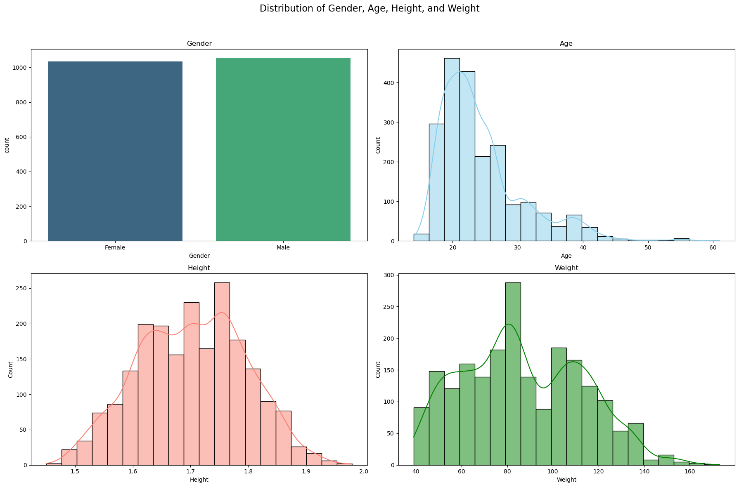
Dataset Profile

Slide 5
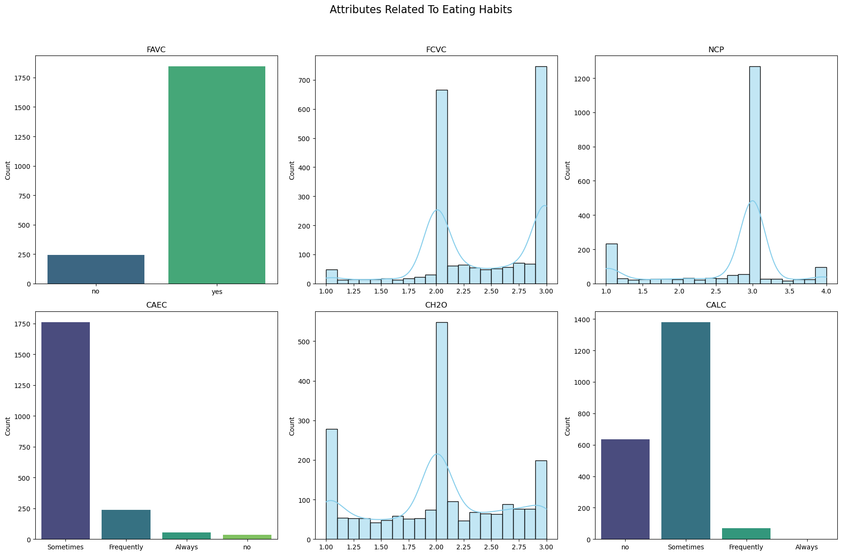
Dataset Profile
FAVC - Frequent consumption of high caloric food
FCVC -Frequency of consumption of vegetables
NCP - Number of main meals
CAEC - Consumption of food between meals
CH2O - Daily consumption of water
CALC - Consumption of alcohol

Slide 6
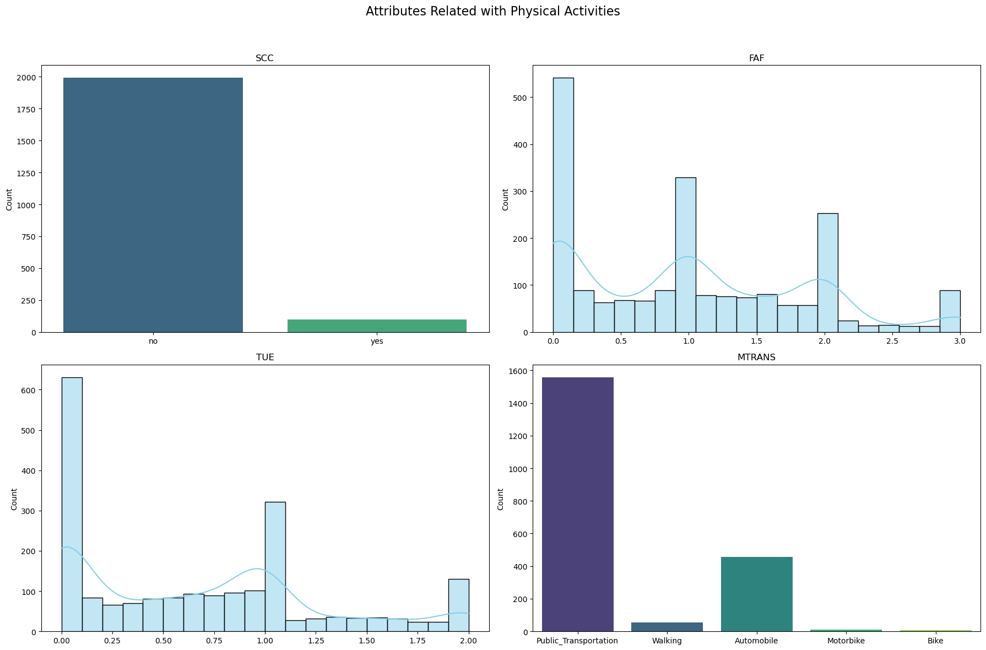
Dataset Profile
SCC - Calories consumption monitoring
FAF - Physical activity frequency
TUE - Time using technology devices
MTRANS -Transportation used

Slide 7
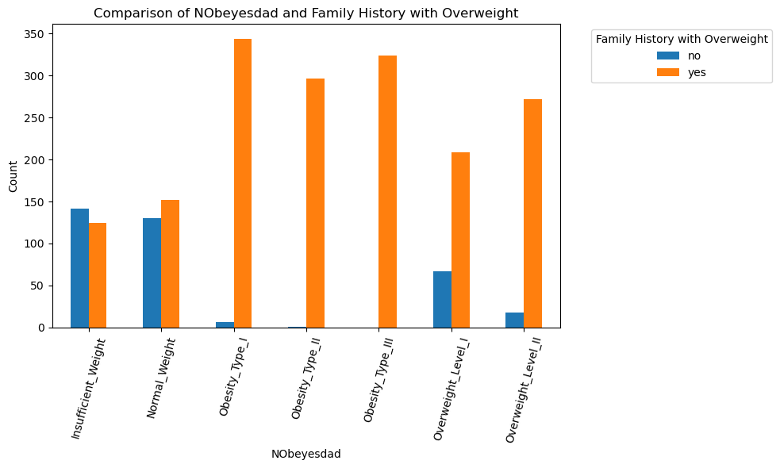
Dataset Profile
NObeyesdad = Obesity Level column

Slide 8
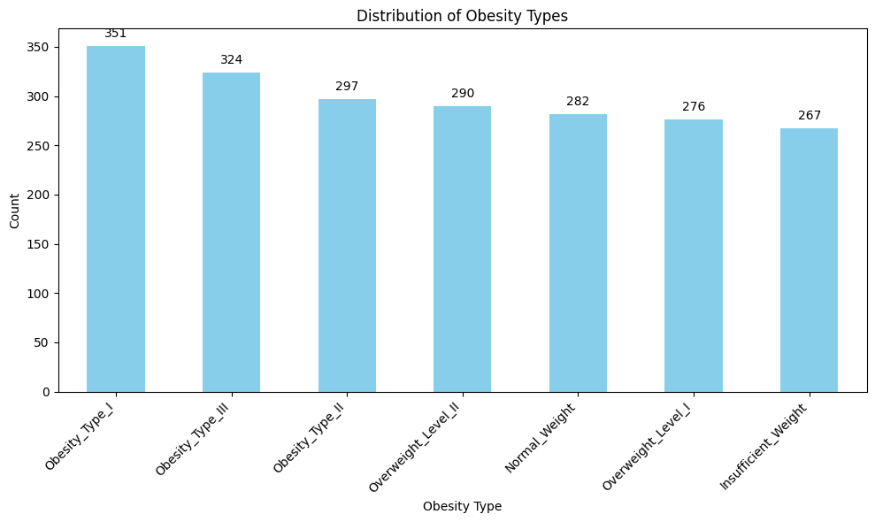
Dataset Profile
Mean: 298.14
Min : 267
Max : 351
Three groups:
Insufficient/Normal Weight
Overweight I and II
Obese I, II, II
(Low, Moderate, High
risks)

Slide 9
Visualisations And Analysis Using Tableau Public

Slide 10
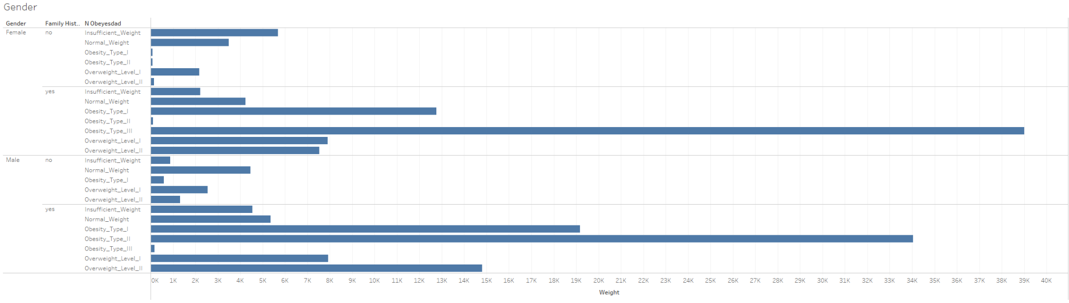
Family History with overweight VS weight (genders)

Slide 11
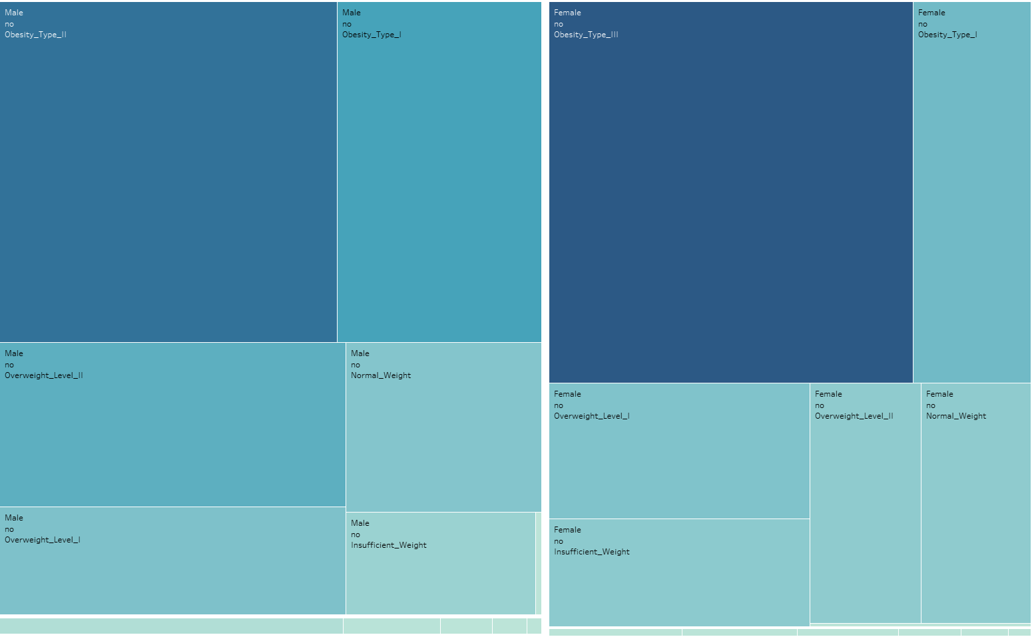
Smoking Vs Weight (Genders)

Slide 12
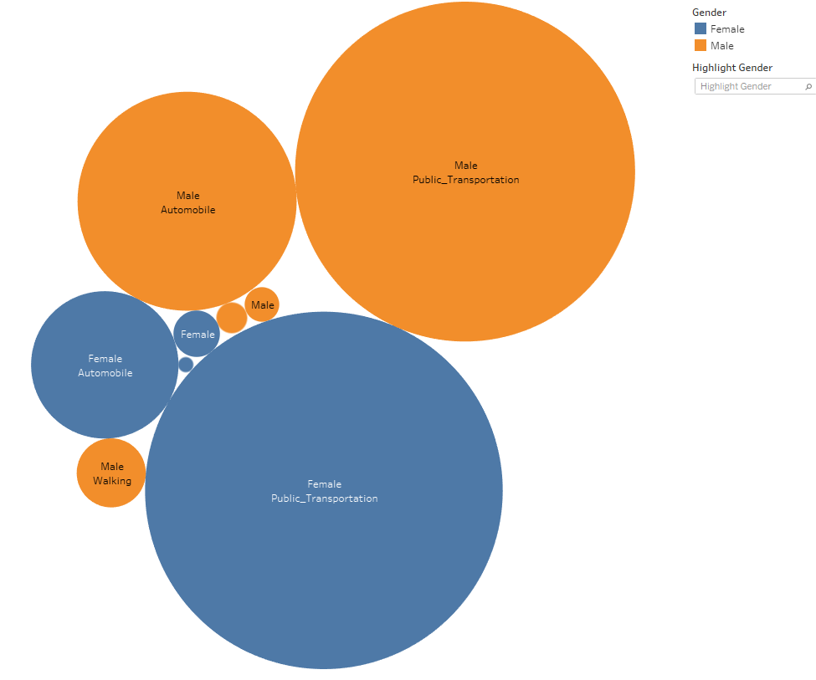
Mode of Transportation VS Weight (Genders)

Slide 13
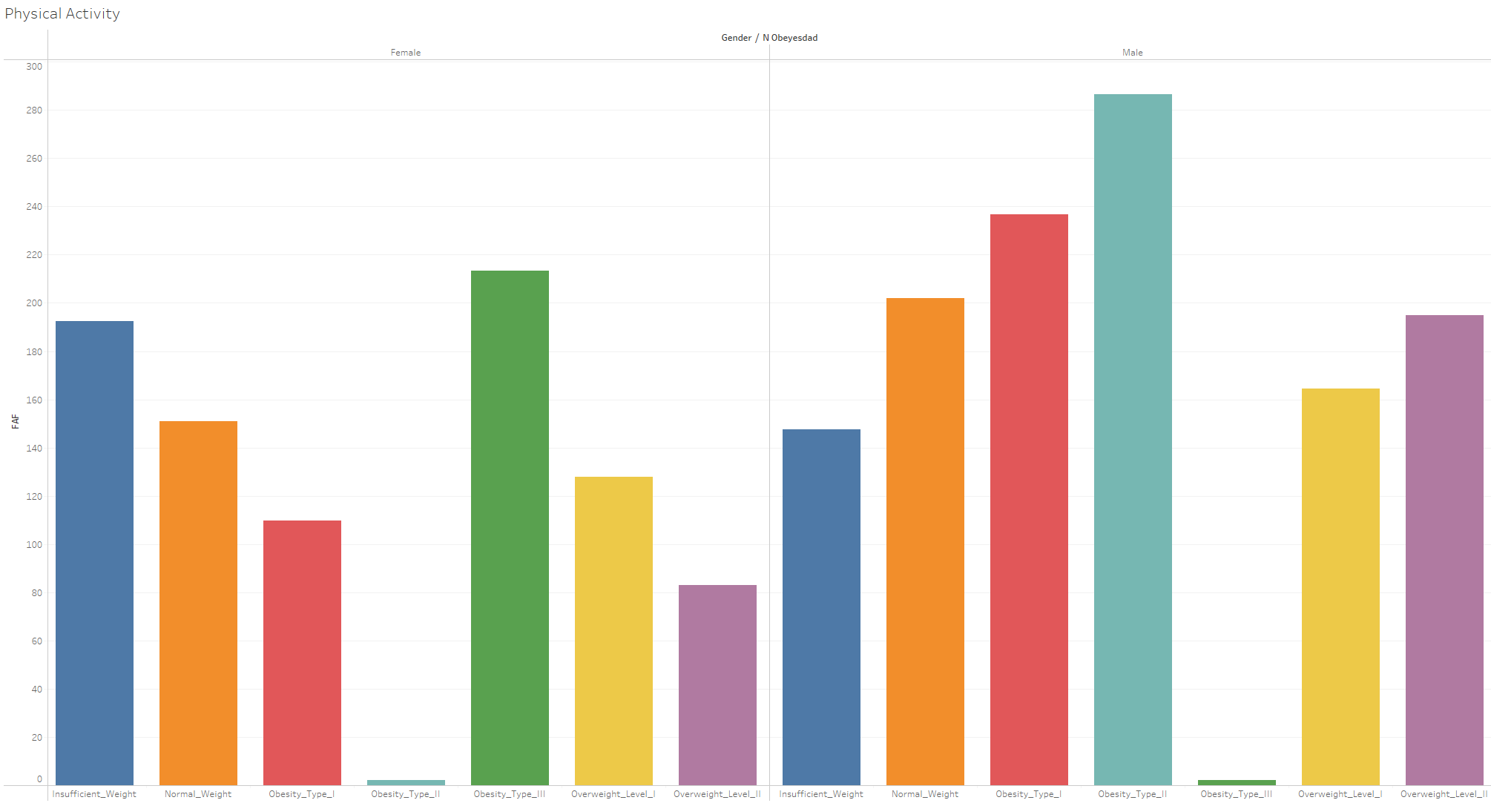
Physical Activity VS Weight (Genders)

Slide 14
Classification Analysis
Logistic Regression
Random forest
KNN

Slide 15
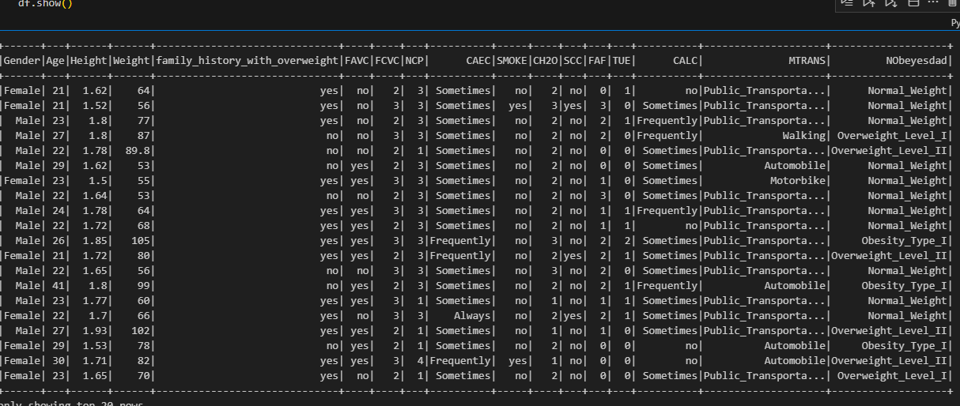
Spark datafile
Features and Target (Nobeysdad)

Slide 16
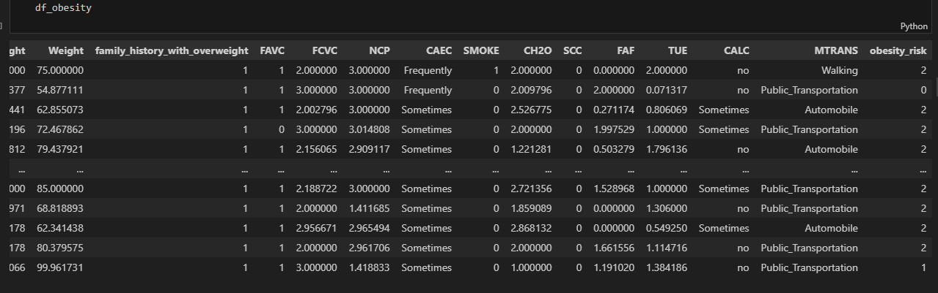
Categorical encoding

Slide 17
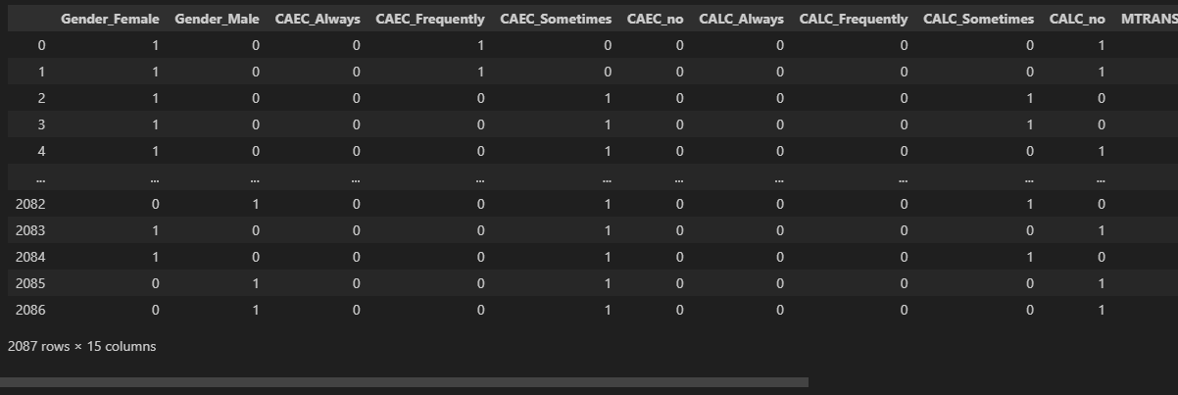
One Hot Encoding

Slide 18
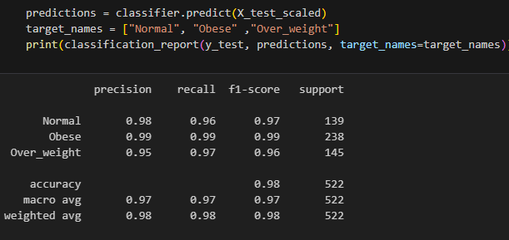
Model Predictions Classification report
Logistic Regression Model
Accuracy score - 0.981

Slide 19
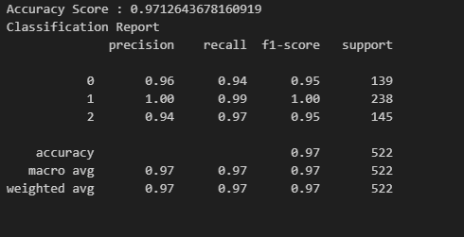
Model Predictions Classification report
Randomforest
Accuracy score - 0.971

Slide 20
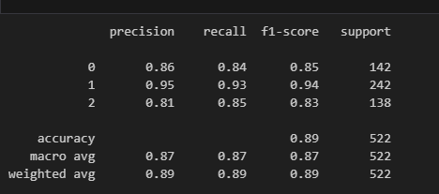
Model Predictions Classification report
K N N
Accuracy score - 0.885

Slide 21
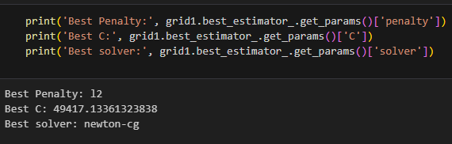
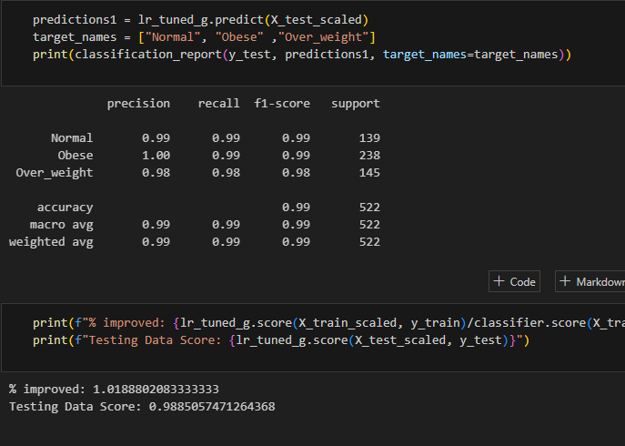
Optimization of Linear regression model by GridSearchCV

Slide 22
Conclusion
It was found that Obesity Level III is more among females while Obesity Level II is more common among males.
Family history with obesity, frequently taking high caloric food, food between meals, etc., are directly related to obesity.
Insufficient Weight and Overweight Level I are more common among those with no family history of obesity.
Logistic regression model is best suitable for predicting obesity level in this dataset with an accuracy of 0.99 after hypertuning of parameters using GridSearchCV.

Slide 23
Reference
https://www.ncbi.nlm.nih.gov/pmc/articles/PMC6710633/pdf/main.pdf
https://www.kaggle.com/datasets/aravindpcoder/obesity-or-cvd-risk-classifyregressorcluster
https://www.worldobesity.org/about/about-obesity/obesity-classification
https://apps.who.int/gho/data/node.main-searo.BMIANTHROPOMETRY?lang=en
https://www.mdpi.com/2075-4418/13/18/2949

Slide 24
Thank you everyone!

